Slide 1
Limitation of Computation Power – P, NP, and NP-complete
Class P
Definition 1 Class P is a class of decision problems that can be solved in polynomial time by (deterministic) algorithms. This class of problems is called polynomial.
Class NP
There is a large number of important problems, for which no polynomial-time algorithm has been found, nor has the impossibility of such an algorithm has been proved. Some samples are:
Knapsack problem Find the most valuable subset of n items of given positive integer weights and values that fit into a knapsack of a given positive integer capacity.

Slide 2
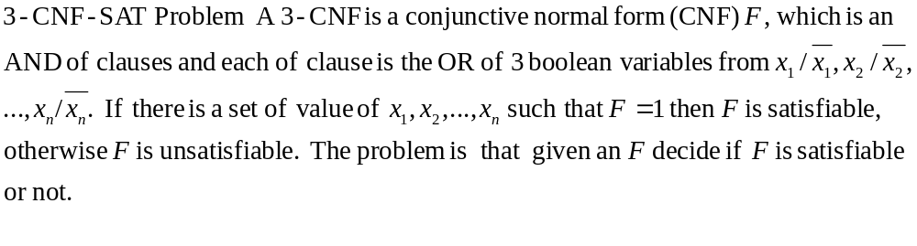
Hamiltonian circuit Determine whether a given graph as a Hamiltonian circuit (a path that starts and ends at the same vertex and passes through all the other vertices exactly once).
Traveling salesman Find the shortest tour through n cities with known positive integer distances between them.
Graph coloring For a given graph, find its chromatic number (the smallest number of colors that need to be assigned to the graph’s vertices so that no two adjacent vertices are assigned the same color).

Slide 3
Example of Traveling sales man problem
Given a graph G, find the shortest simple circuit (Hamiltonian circuit) in G which passes through all the vertices.
2
Tour length
abcda 18
abdca 11
…
Totally there are P(4,4)=4! tours.
a
b
8
7
3
5
c
d
1
Generally, there may have n! tours in a graph of n vertices and if we check all the tours the computing time is O(n!).
People couldn’t find a good algorithm (using polynomial time) to solve it!

Slide 4
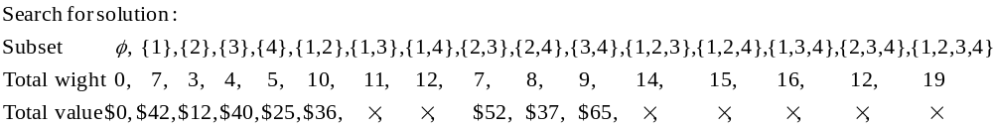
Example of Knapsack problem
knapsack: W=10
item 1: w=7, v=$42 item 2: w=3, v=$12, item 3: w=4, v= $40, item 4: w=5, v=$25
People couldn’t find a good algorithm (using polynomial time) to solve it !

Slide 5
Definition 2 A nondeterministic algorithm is a two-stage procedure that takes as its input an instance I of a decision problem and does the following.
Nondeterministic (“guess”) stage: generate a candidate solution S to the given instance I.
Deterministic (“verification”) stage: A deterministic algorithm takes both I and S as its input, and it outputs yes if S is a solution to instance I.
Definition 3 Class NP is the class of decision problems that that can be solved by nondeterministic polynomial algorithms. This class of problems is called nondeterministic polynomial.
Famous Problem: P = NP ?

Slide 6
Class NP-complete
Definition 3 A decision problem D1 is said to be polynomially reducible to a decision problem D2 if there exists a function t that transforms instances of D1 to instances of D2 such that
t maps all yes instances of D1 to yes instances of D2 and no instances of D1 to no instances of D2;
t is computable by a polynomial-time algorithm.
If a problem D1 polynomially reducible to some problem D2 that can be solved in polynomial time, then problem D1 can also be solved in polynomial time.
Definition 4 A decision problem D is said to be NP-complete if
It belongs to class NP;
Every problem in NP is polynomially reducible to D.

Slide 7
Class P
Class P-complete
Class NP

